Slide 1
Debit And Credit Banking Data Presentation Using MS Excel, MySQL, Power BI & Tableau By Group 4

Slide 2
Summary:
We performed an analysis on Banking data for debit and credit having 100,000 records and drawn KPI from it using excel, my SQL and also used visualization tools like tableau and also used power bi to make dynamic dashboard.
We got some insights of the bank's financial transaction performance across different branches, banks, time periods, and methods. It displays aggregated metrics and visualizations related to transaction volume, distribution, and account activity.

Slide 3
Key Performance Indicators (KPIs)
KPI | Value | Description
Total Credit Amount | ₹127.60 Cr | Sum of all credit transactions across branches.
Total Debit Amount | ₹127.29 Cr | Sum of all debit transactions across branches.
Credit to Debit Ratio | 1.00:1 | Indicates a balance between incoming and outgoing transactions.
Net Transaction Amount | ₹3,18,117.19 | Net monetary value after balancing debit and credit totals.
Account Activity Ratio | 0.0002:1 | Likely represents transaction activity per account, possibly underutilized.

Slide 4
Transaction Distribution by Branch
Main Branch (₹42.84 Cr)
City Center (₹42.91 Cr)
North Branch (₹41.68 Cr)
Others close in range
All branches perform comparably, with Main Branch (₹42.84 Cr) leading slightly.
North Branch (₹41.68 Cr) records the lowest amount.

Slide 5
Transaction Method Split
Bank Transfer: 33.41%
Credit Card: 33.27%
Debit Card: 33.32%
Nearly equal split across Bank Transfer (33.41%), Credit Card (33.27%), and Debit Card (33.32%), indicating diversified usage.

Slide 6
Bank-Wise Amount Distribution
Axis Bank, ICICI Bank, State Bank: 17%
HDFC Bank, Punjab National: 16%
Kotak Mahindra Bank (likely lower)
Top participating banks include Axis Bank, ICICI Bank, and State Bank of India, each holding 17% of transaction share.
HDFC Bank and Punjab National Bank follow with 16%.

Slide 7
Monthly Transaction Volume
Highest: May (9344)
Lowest: May (305 )
May (9344 transactions) had the highest volume.
December and July also showed strong activity.
January and February were comparatively lower in transaction count.

Slide 8
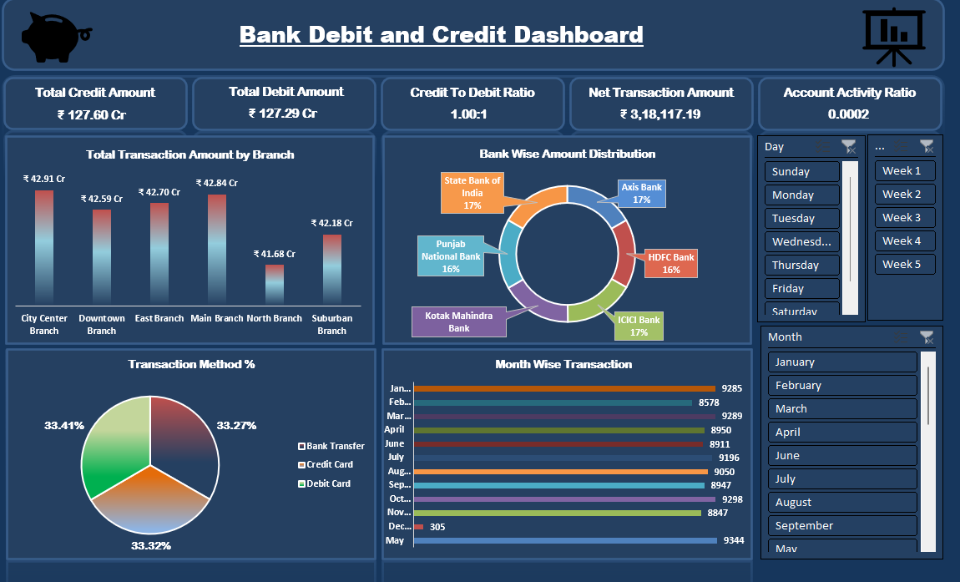
Excel Dashboard

Slide 9
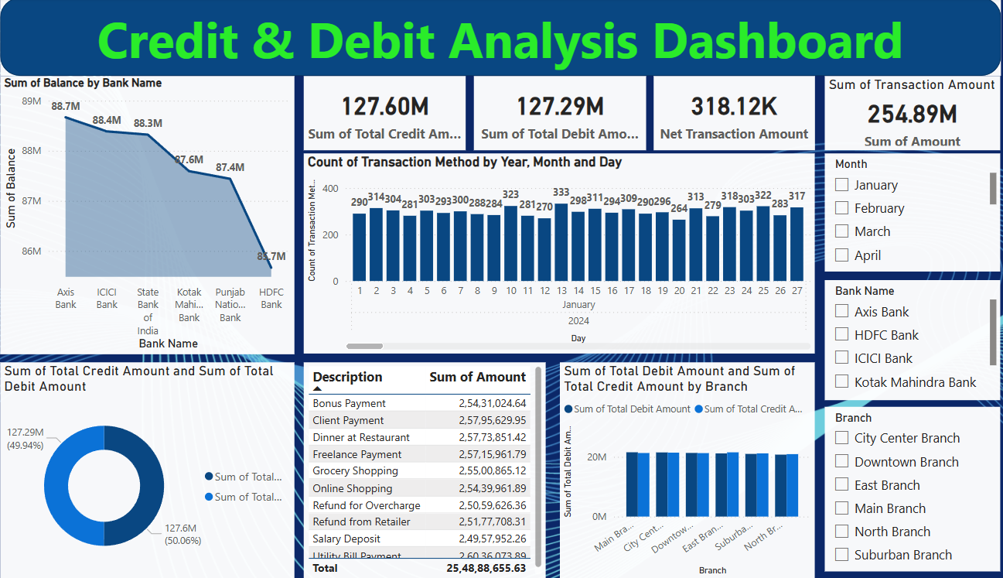
Power BI Dashboard

Slide 10
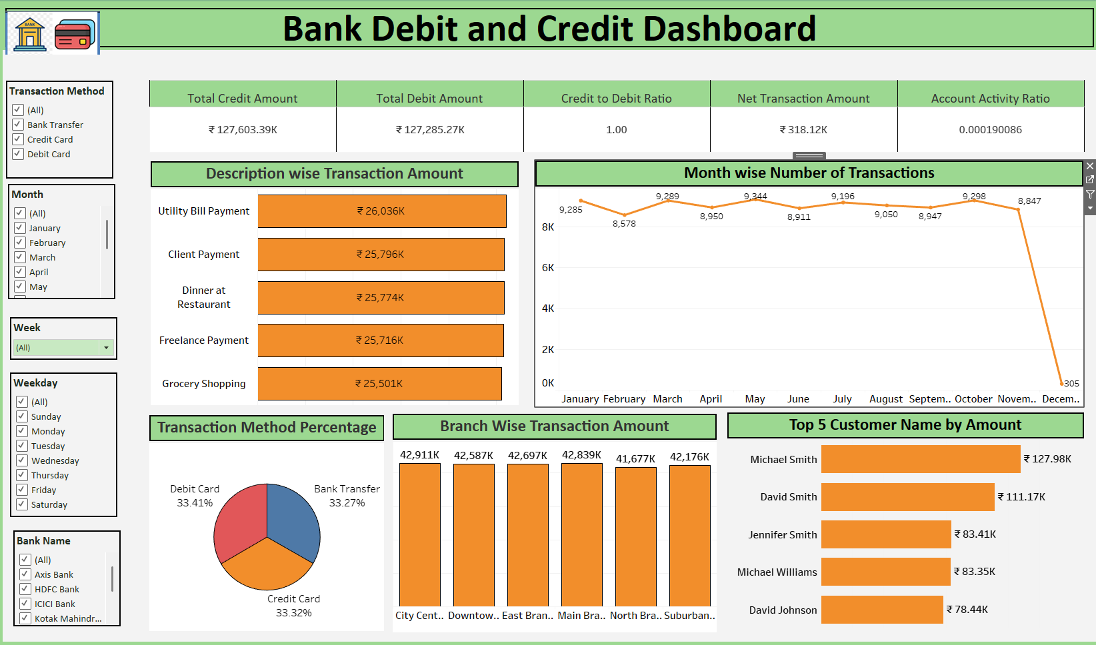
Tableau Dashboard

Slide 11
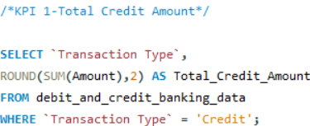
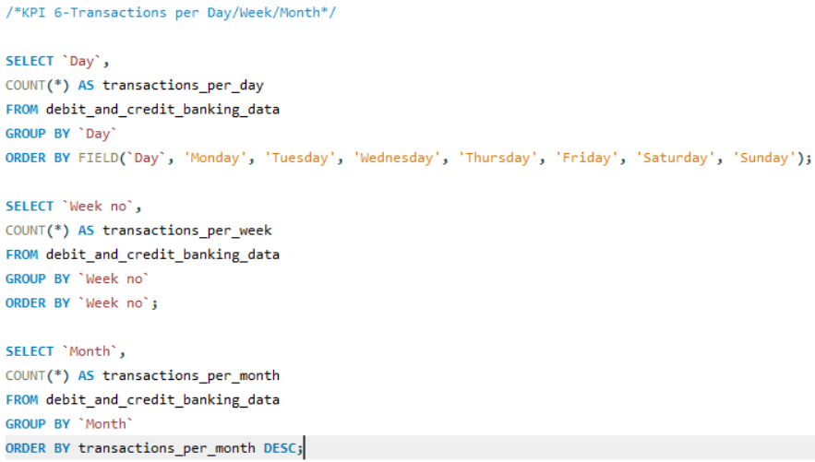
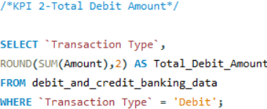
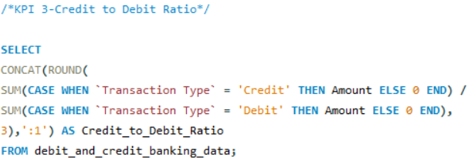
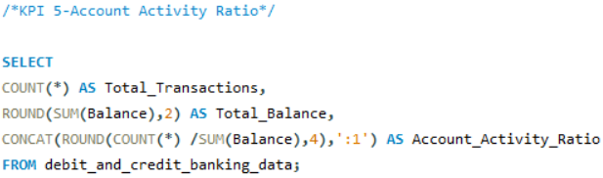
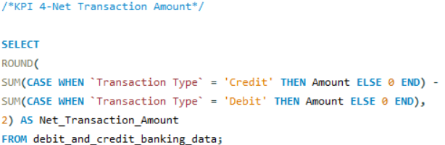
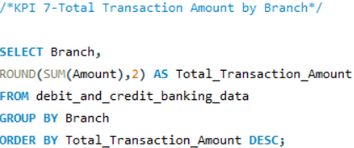
SQL Queries

Slide 12
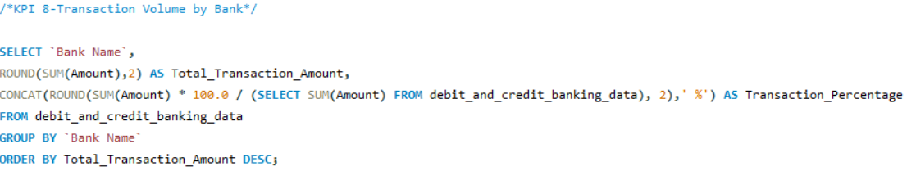
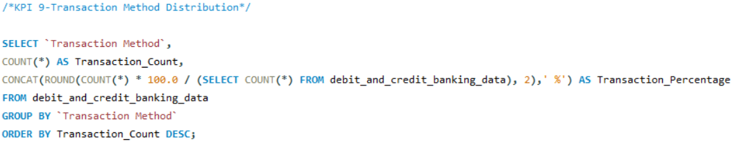
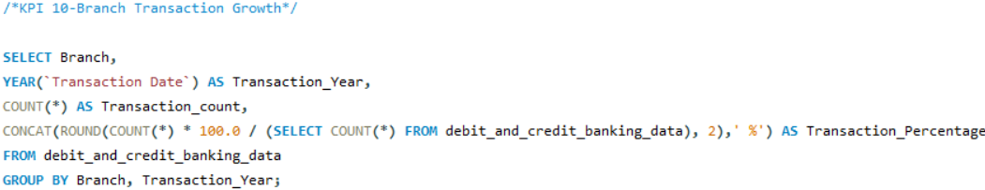
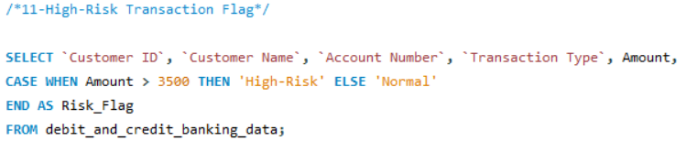
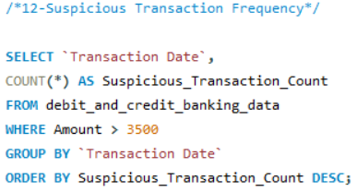
SQL Queries

Slide 13
Key Takeaways & Insights
Balanced credit/debit flows ensure financial stability.
Broad usage of all transaction methods—diversified customer behavior.
Consistent branch performance suggests strong network.
May is peak month—could align with seasonal trends or campaigns.

Slide 14
Thank You

